Slide 1


National Conference on Recent Trends in Science, Engineering and Technology (RTSET-2023) Buddha Institute of Technology , GIDA, Gorakhpur Date of Conference: 6th -7th April, 2023
Presentation on Speech Emotion Reorganization
Pawanesh KumarYadav (1905250130035)
Priyanka Jaiswal (1905250130037)
Vandana Kushwaha (1852513057)
Rupali Dubey (1905250130043)
Under the Guidance of
Mr. Manish Kumar Gupta
(Head of Department IT)

Slide 2
Contents
Introduction
Literature Survey
Research Gap
Problem Statement
Proposed Solution / Methodology
Experimental Results
Conclusion & Future Work
References
2

Slide 3
Introduction
[1] There are many ways of communication but the speech signal is one of the fastest and most natural methods of communications between humans. Therefore the speech can be the fast and efficient method of interaction between human and machine also.
[1] Humans have the natural ability to use all their available senses for maximum awareness of the received message.
[3] Therefore the purpose of emotion recognition system is to use emotion related knowledge in such a way that human machine communication will be improved.
[1] Speech Emotion Recognition (SER) is the task of recognizing the emotional aspects of speech irrespective of the semantic contents.
[4] In speech monologues, emotional recognition is an area traditionally studied in psychology and cognitive science, but in modern generations, the data science domain has [2] been especially engaged in this area.
[1] Here becomes the main understanding of the value of human– machine interfaces in speech communication. The essential and motivating aspect of Human-Computer Interaction (HCI) is the identification of emotions by speech signals
3

Slide 4
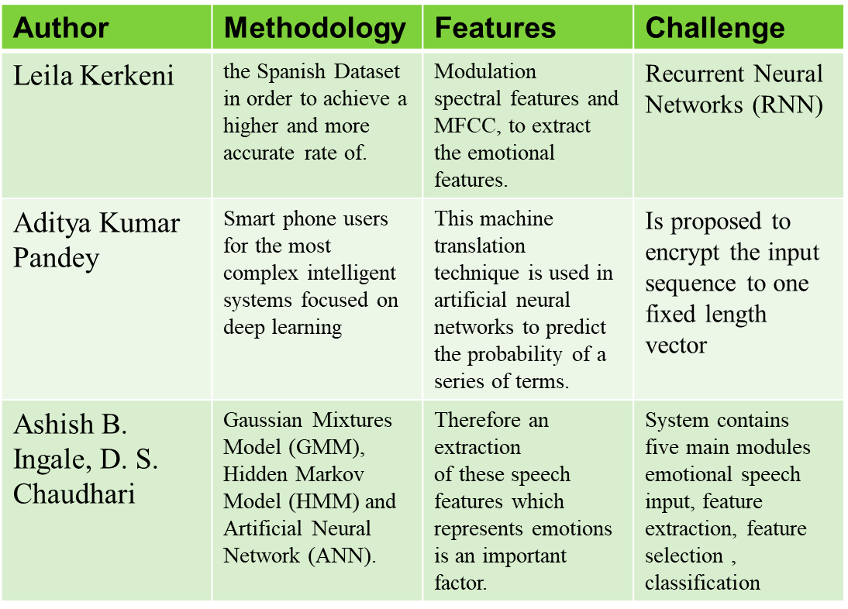
Literature Survey
4

Slide 5
Research Gap
One major research gap in SER is the lack of standardized datasets for training and testing SER models. While there are several publicly available datasets for SER, they often have limited size and variability, which can limit the generalizability of SER models.
Another research gap in SER is the lack of consensus on the appropriate feature extraction and classification methods to use for SER. Different studies have used a variety of feature extraction techniques, including spectral and prosodic features, as well as different classification methods, such as SVM, Neural Networks, and Deep Learning.
A third research gap in SER is the need for more real-world applications and evaluations. While there have been many studies on SER in laboratory settings, there is a need for more studies that evaluate the effectiveness of SER in real-world scenarios, such as call centers, virtual assistants, or emotional support systems.
5

Slide 6
Problem Statement
The problem statement in speech emotion recognition (SER) is to develop machine learning models that can accurately recognize and understand human emotions conveyed through speech.
Emotions are a critical aspect of human communication, and SER can have many practical applications, such as in virtual assistants, call centers, and mental health support systems.
However, developing accurate SER models is challenging due to the complex and multi-dimensional nature of emotions and the variability in how they are expressed in speech.
To address these challenges, researchers in SER need to develop novel techniques for feature extraction and classification, evaluate their effectiveness using standardized datasets, and test their performance in real-world applications.
6

Slide 7
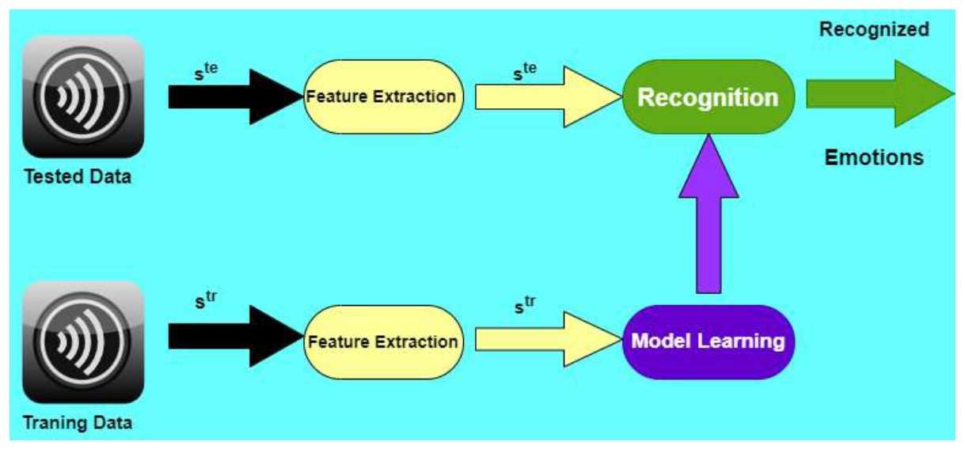
Proposed Methodology / Solution
7

Slide 8
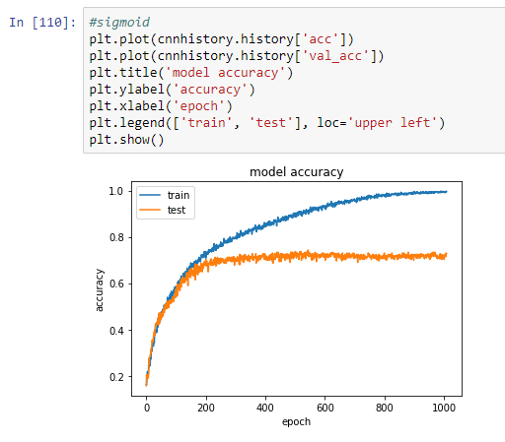
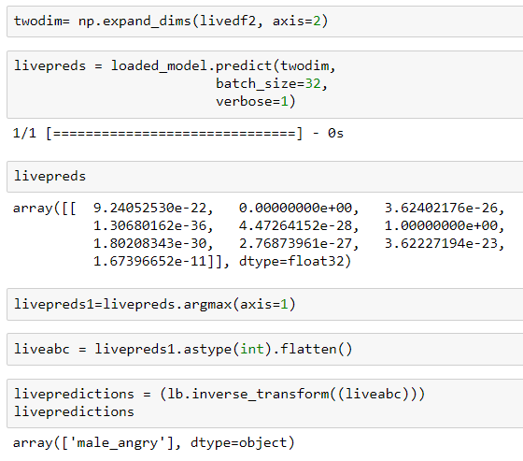
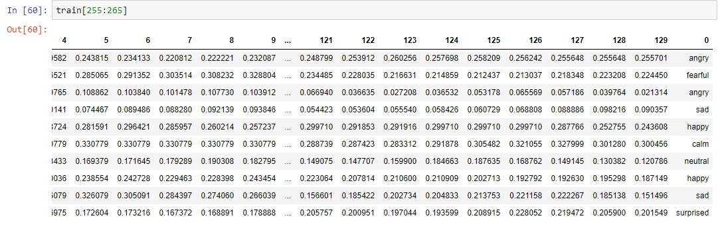
Experimental Results
8

Slide 9
Conclusion & Future Work
Speech emotion recognition (SER) is a rapidly developing field of research that aims to enable machines to recognize and understand human emotions conveyed through speech.
Accurate SER has many practical applications, such as in virtual assistants, call centers, and mental health support systems. However, developing accurate SER models is challenging due to the complex and multi-dimensional nature of emotions and the variability in how they are expressed in speech.
Our Future Scopes are :-
Multimodal emotion recognition
Novel deep learning models
Contextual information
9

Slide 10
References
[1] https://www.sciencedirect.com/science/article/pii/S2214785320398928
[2] https://www.sciencedirect.com/topics/computer-science/speech-emotion_x0002_recognition
[3]https://www.researchgate.net/publication/257470335_Speech_emotion_recognition_Features_and_classification_models
[4] https://www.roboticstomorrow.com/article/2021/09/understanding_x0002_human-machine interfaces-hmis/17446
[4] https://basicknowledge101.com/pdf/km/machine_learning_outline.pdf
[5] https://labelyourdata.com/articles/ai-emotion recognition#:~:text=AI%20reading%20human%20faces%20to%20recognize%20emotions%20Emotion,emotions%3A%20fear%2C%20anger%2C%20happiness%2C%20sadness%2C%20disgust%2C%20and%20surprise.
[6] https://www.verywellmind.com/what-is-observational-learning-2795402
12

Slide 11
Thank You
Q/A

